Slide 1
NestJS - The missing piece to easily develop full-stack TypeScript web applications

Slide 2
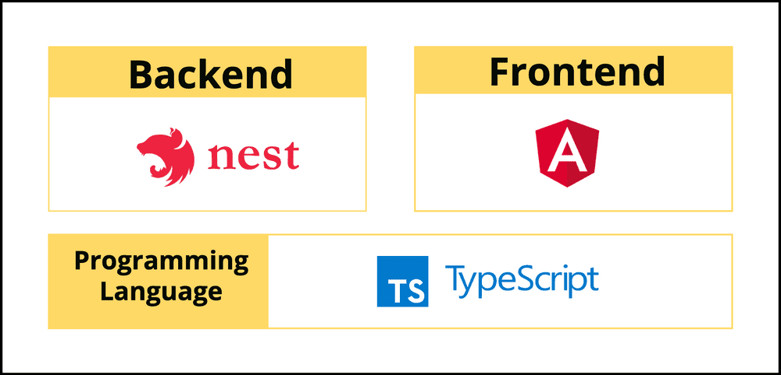
NestJS - The missing piece to easily develop full-stack TypeScript web applications

Slide 3
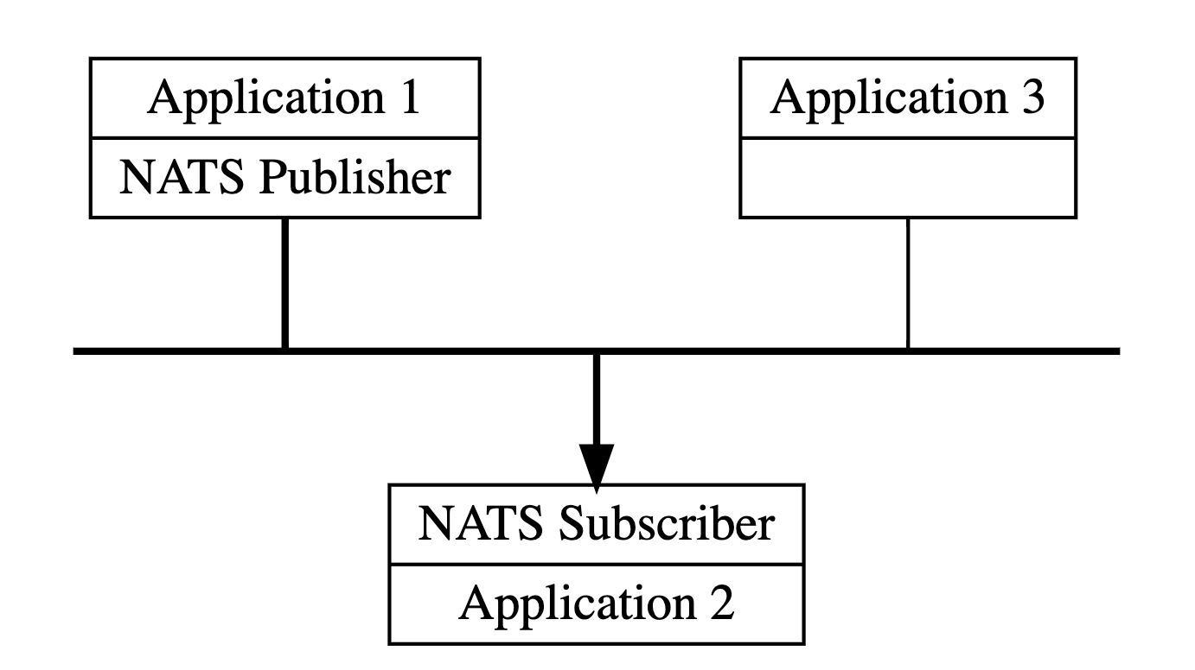
A little bit theory…
Notes:
NATS messaging enables the exchange of data that is segmented into messages among computer applications and services. These messages are addressed by subjects and do not depend on network location. This provides an abstraction layer between the application or service and the underlying physical network. Data is encoded and framed as a message and sent by a publisher. The message is received, decoded, and processed by one or more subscribers.
Clients connect to the NATS system, usually via a single URL, and then subscribe or publish messages to subjects.
NATS core offers an at most once quality of service. If a subscriber is not listening on the subject (no subject match), or is not active when the message is sent, the message is not received. This is the same level of guarantee that TCP/IP provides. By default, NATS is a fire-and-forget messaging system.

Slide 4
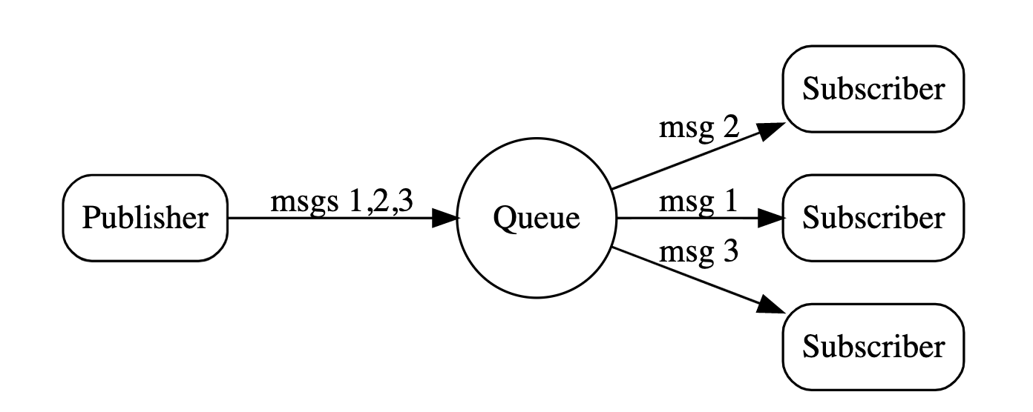
A little bit theory…
Notes:
NATS provides a built-in load balancing feature called distributed queues. Using queue subscribers will balance message delivery across a group of subscribers which can be used to provide application fault tolerance and scale workload processing.
To create a queue subscription, subscribers register a queue name. All subscribers with the same queue name form the queue group. This requires no configuration.
One of the great features of NATS is that queue groups are defined by the application and their queue subscribers, not on the server configuration.

Slide 5
Coming back to nestJS
In Nest, a microservice is fundamentally an application that uses a different transport layer than HTTP.
Nest supports several built-in transport layer implementations, called transporters, which are responsible for transmitting messages between different microservice instances. Most transporters natively support both request-response and event-based message styles.
Nest abstracts the implementation details of each transporter behind a canonical interface for both request-response and event-based messaging. This makes it easy to switch from one transport layer to another -- for example to leverage the specific reliability or performance features of a particular transport layer -- without impacting your application code.
It might look something like this if we have two services in our architecture. ServiceA might process a request and call ServiceB to get another piece of information.
What we have here is synchronous HTTP calls between the two services. This is a viable communication pattern, but it does create coupling between the two services that we likely don’t need.
Notes:
The core of Nest microservices, and the key to understanding them, is what Nest calls transporters. Transporters enable you to connect components over a network using a pluggable communications layer and a very simple application-level message protocol. Nest delivers a variety of transporters out-of-the-box, as well as an API allowing developers to build new custom transporters. This combination of architecture and features is extremely powerful.
integrating NestJS applications with other applications and services. This can be accomplished in several different ways.
This is done by a combination of Nest microservices and a message broker as the glue. In other words, Nest apps and external apps communicate with each other asynchronously through a message broker.
In Nest, a microservice is fundamentally an application that uses a different transport layer than HTTP.
Nest supports several built-in transport layer implementations, called transporters, which are responsible for transmitting messages between different microservice instances. Most transporters natively support both request-response and event-based message styles. Nest abstracts the implementation details of each transporter behind a canonical interface for both request-response and event-based messaging. This makes it easy to switch from one transport layer to another -- for example to leverage the specific reliability or performance features of a particular transport layer -- without impacting your application code.

Slide 6
Why do we need nestJS mS:
scalability and fault tolerance to your Nest application(s).

Slide 7
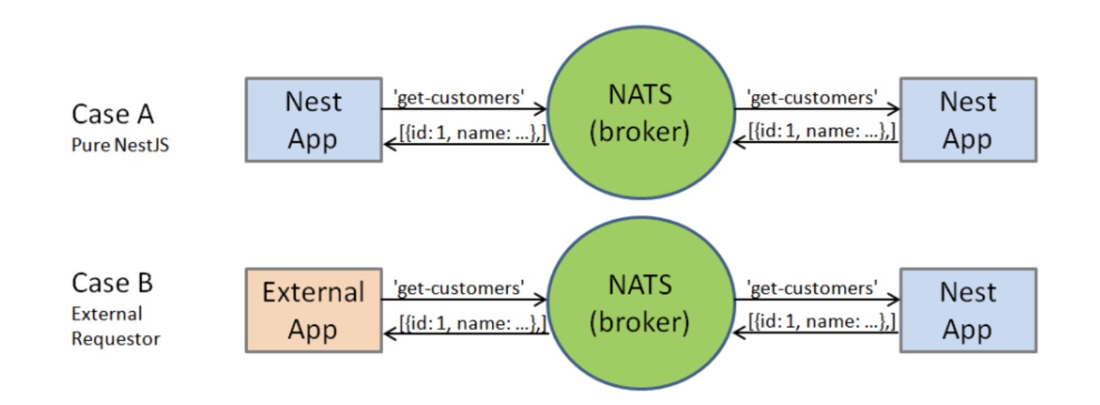
Notes:
The key advantage of broker-based messaging systems is they allow you to decouple the various application components from each other. Each need only connect to the broker, and can remain unaware of the existence of, location of, or implementation details of other components. The only thing the components need to share is a message protocol.
צמידות נמוכה

Slide 8
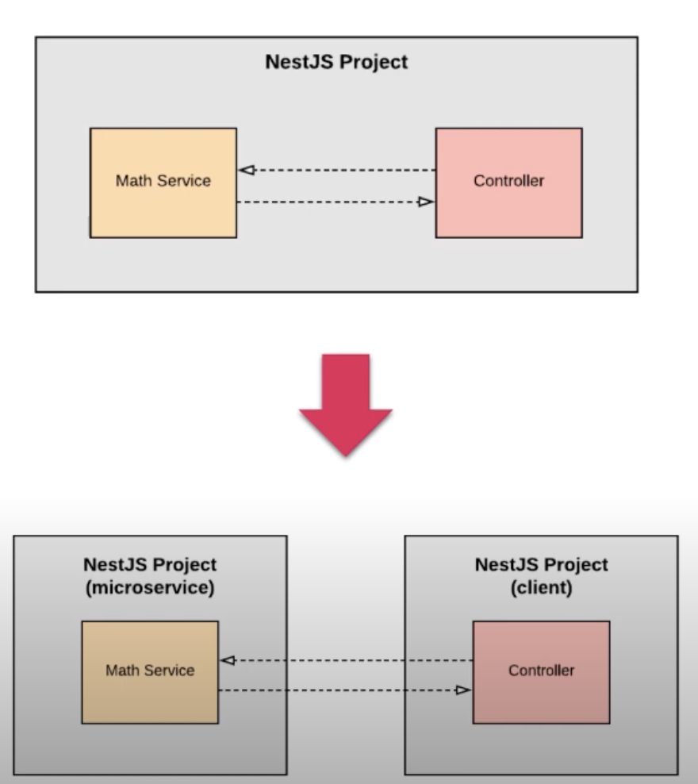

Slide 9
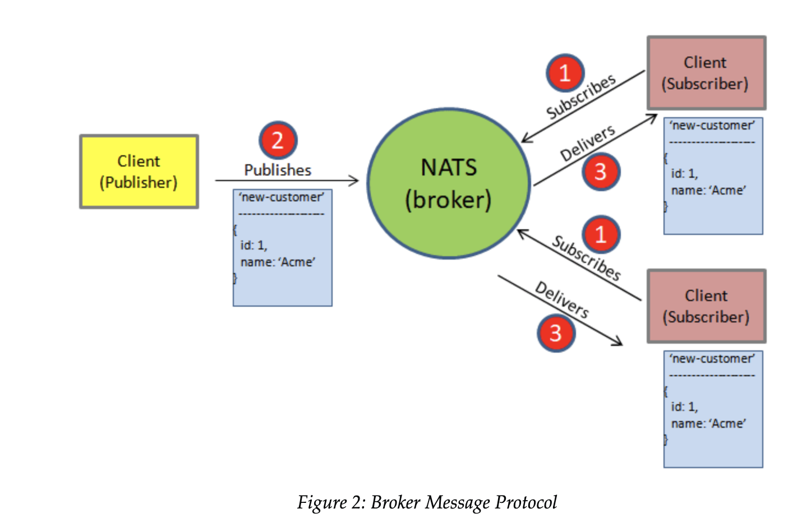
Notes:
One thing obviously missing from this diagram is the request/response style communication model. This communication style is useful when we want to verify receipt of a published message and/or receive a response from whoever consumes the message. In fact, this is the style of message implicit in Figure 1 above (where we can infer that 'get-customers' is a request and the array of customers is a response). How do we get from publish/subscribe to request/response?
Nest (as well as some of the brokers natively, including NATS as we'll soon see) solve this problem in a handy way, by building a request/response capability on top of the publish/subscribe model. Let's say component A wishes to "get customers" from component B, which has access to a customer DB. Component A can publish a "get customers" message, and (assuming it has subscribed to that topic) component B receives it, queries the customer DB for a list of customers, and sends a response message. The response message is where the magic happens. In order for B to respond to A, they both must do a few things, agreed upon by convention:
A chooses a response topic (sometimes called a reply subject)
A subscribes to the response topic
A passes the response topic as part of the initial message
B uses the response topic as the topic of its own subsequent response message
In other words, if a response topic is included in a message received by a subscriber, the subscriber publishes a response message on that response topic. Thus, in our example, B publishes its response, including a payload containing the customer list, on the response topic it received in the "request" message. Because A previously subscribed to the response topic, it receives the response as a normal message. All very tidy!

Slide 10
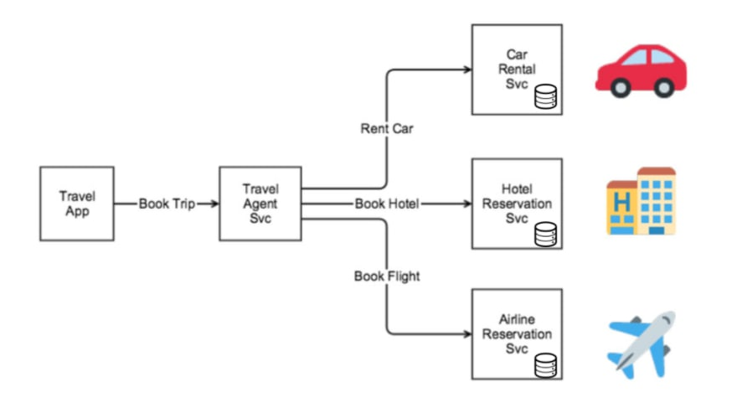
Use case

Slide 11
We have transformed the communication between the two services from synchronous to asynchronous. Now, the first service is no longer stuck waiting for the second service to complete before returning from its work.
With this approach, we keep the services isolated from one another, and the coupling is loose. The downside is that it creates extra HTTP requests on the second service; it is now going to be polled from the outside until the request is completed. This introduces complexity on the client as well since it now must check the progress of the request.
But asynchronous communication allows the services to remain loosely coupled from one another.
Unlike HTTP communication, the services involved do not directly communicate with each other. Instead, the services push messages to a message broker that other services subscribe to. This eliminates a lot of complexity associated with HTTP communication.
It doesn’t require services to know how to talk to one another; it removes the need for services to call each other directly. Instead, all services know of a message broker, and they push messages to that broker. Other services can choose to subscribe to the messages in the broker that they care about.

Slide 12
Event-driven communication
The final communication pattern we will visit in this post is the event-driven pattern. This is another asynchronous approach, and it looks to remove the coupling between services altogether.
Unlike the messaging pattern where the services must know of a common message structure, an event-driven approach doesn’t need this. Communication between services takes place via events that individual services produce.
A message broker is still needed here since individual services will write their events to it. But, unlike the message approach, the consuming services don’t need to know the details of the event; they react to the occurrence of the event, not the message the event may or may not deliver.
In formal terms, this is often referred to as “event only-driven communication.” Our code is like our messaging approach, but the event we push to SNS is generic.

Slide 13
Kafka:Although it is commonly referred to as a queue, it is more accurate to say that it is something in between a queue and a database, with attributes and tradeoffs from both types of systems.

